Slide 1
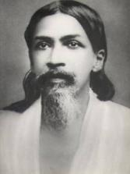
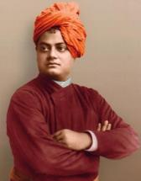
KALIYUVA MANE
a free child-centric alternative school
for the Opportunity-deprived children
Children
for SCHOOL
School for
CHILDREN
Sri Aurobindo
Swami Vivekananda
Our Inspiration
Compassion Patriotism Spirituality

Slide 2
We believe…
Natural Resources & Human resources are two vital ingredients that are too valuable; not to be wasted.
Education is the tool to transform ordinary human being into a valuable resource.
Every educated person is an asset to the society.
Every child deserves an opportunity to learn.

Slide 3
Who are “Out-of-System” children
Mainstream education system assumes:
“All children are like machines who can learn a predetermined textual content in a predetermined time interval and in a predetermined way.”
But due to:
Lack of learning environment in home & school
Turbulent childhood
Insensitivity towards child’s varied emotions, abilities, and interests
Many mentally sound children are deprived of an opportunity to learn in regular schools (Free or Paid).

Slide 4
Kaliyuva Mane…A Child-centric education system
Kaliyuva Mane
Love, Care & Empathy
Innovation
Child-centricity
Alternative Education

Slide 5
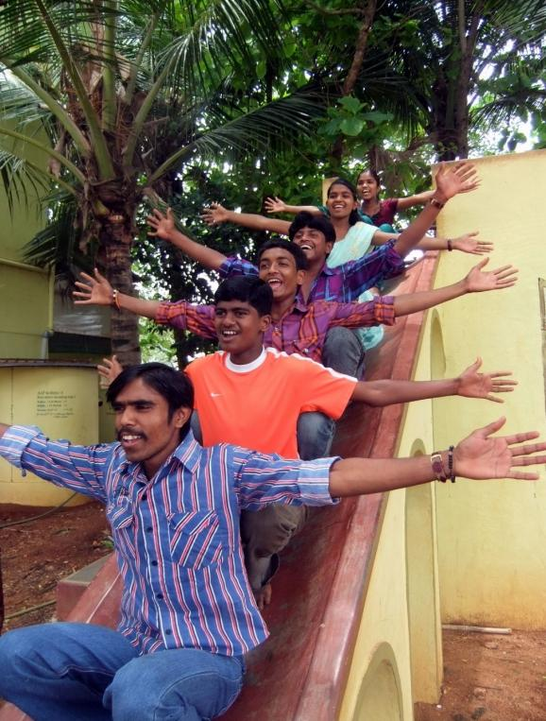
Let us
share some Success
Stories first!!

Slide 6
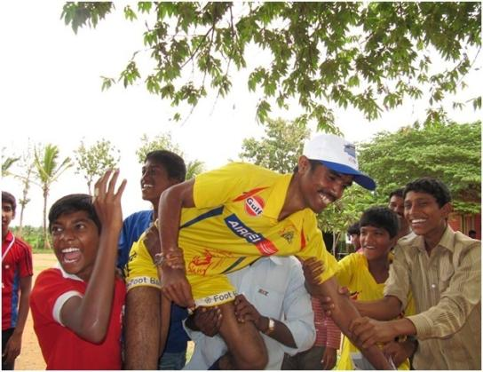
From a dropout to an industry employee
A rural school dropout in 2007.
13 years old Manu
knew only to write his name in Kannada.
Passed 10th standard in 2012.
Underwent training at CIPET, Mysore
Employed now in a private company.
Where is the formal school for a 13 year old child with IQ:100
but at an academic level of LKG ?

Slide 7
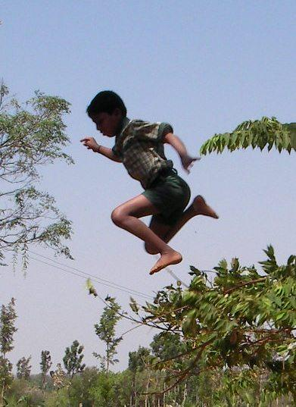
Leaping into the future
June 2006 [Joined Kaliyuva Mane as a resident scholar]
Mahesha was 11 years old.
He was on the verge of dropping out of a rural free school due to acute poverty.
Joined the school as a resident scholar.
June 2017
A BBM graduate with 74.5% marks.
Currently working in Kaliyuva Mane, as an accountant. Dreams to become a bank officer!

Slide 8
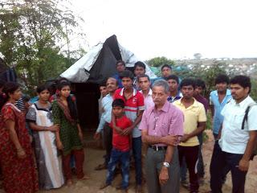
Was there any school for this girl?
November 2012 [Joined KM
as a resident scholar]
Girl’s family lives in a slum.
Father lives in his own alcoholic world.
Mother does odd jobs to take care of 3 kids.
Girl has dropped out of Government schools thrice.
Girl has worked as a child labour for two years washing utensils and taking care of a baby.
The girl is 12 years & 9 months old
She has to be taught from alphabets and numbers.
She does not have any records like TC or Birth certificate.
2016
The girl not only completed 10th standard examination, but now continuing her further studies.

Slide 9
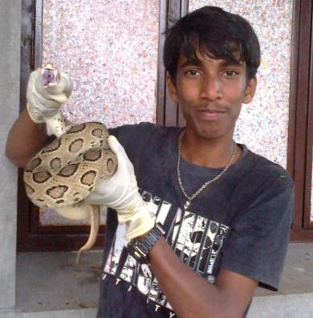
There is a film for dyslexic, but not a school
June 2010 [Joined Kaliyuva Mane]
12 year old Hemanth was studying in a reputed English medium school but could not cope up with the studies.
Was subjected to a lot of humiliation at home & school, but completed 7th standard. Thanks to the system of promoting children irrespective of learning.
But as per the report of clinical psychiatrist of AIISH, his IQ was 100, academic level was at initial stage of 3rd standard. He was dyslexic.
Where is the school for a
13 year old school going child suffering from an
academic lag of 5 years?
April 2017
Passed 10th standard in 2014.
Currently pursuing Diploma in Engineering, after completing the ITI course.

Slide 10
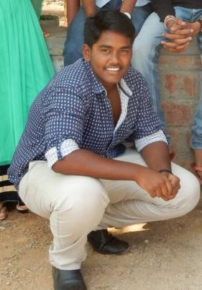
Where is the school for this bright boy?
Yogesh Ponting’s parents are Post-Graduates. Father is a Businessman; mother is H.M. of a convent
Ponting completed 7th Standard from a reputed English medium school.
For 8th standard he joined a school of better reputation, but he couldn’t adjust to the new environment. He failed in 2 subjects in 9th standard, Parents wanted to see his progress report; School authorities wanted to meet his parents.
Because of the pressure of learning, the boy refused to go to School again. Other reputed schools refused the admission for this boy. So his parents brought him to Kaliyuva Mane in September 2014 reluctantly. Yogesh liked the environment at Kaliyuva Mane and started learning.
2016 April
Yogesh passed 10th standard securing 74% of marks

Slide 11
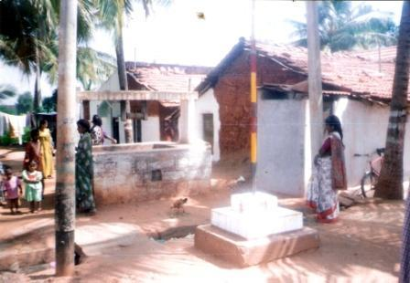
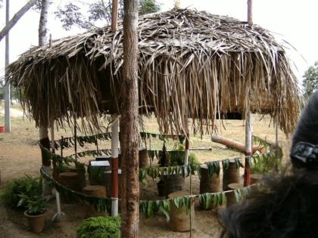
Conceptualization of Kaliyuva Mane
Srirampura village
Kenchalagudu Village
August 1992
Beginning of free supplementary classes for rural children
June 2005
Beginning of a free experimental school for opportunity-deprived children

Slide 12
Deviations from the Regular School
Admission process throughout the year
Adequate time for a child to feel comfortable and settle down
Curriculum tailored on the child’s current knowledge and age
Flexible teams rather than dividing children into rigid standards

Slide 13
Deviations from the Regular School
No fear instilling exams. Only informal tests.
Neither a formal Kannada medium school nor an English medium school
Individual attention to each child’s emotions, interest & abilities, as happy minds learn faster

Slide 14
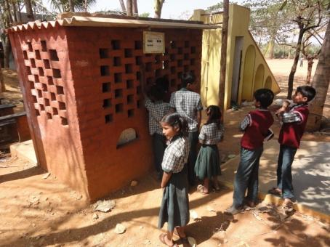
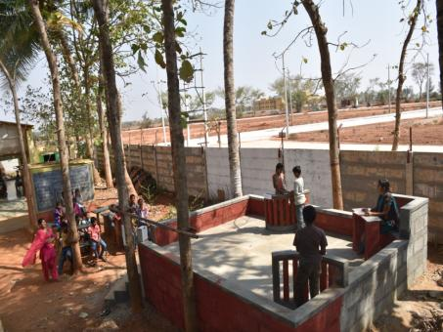
Innovative Learning Areas
Kids’ Bank: A unique concept to teach children, the value of money and materials, their limitations, banking transactions and arithmetical skills.
Kids’ Court - Transformation
Children file petitions seeking justice. Children’s disputes are being settled here.
This is an attempt adopted at Kaliyuva Mane to inculcate values.

Slide 15
Vision & Mission of Kaliyuva Mane
Vision: Happy childhood & child-centric education for all
Mission:
To transform opportunity deprived children into self-reliant citizens by giving them Love, Care, Empathy and Education
To carry intense grass root level research about development and education of opportunity deprived children through a free child-centric alternative school
To share the research findings with the stakeholders and assist them in replication

Slide 16
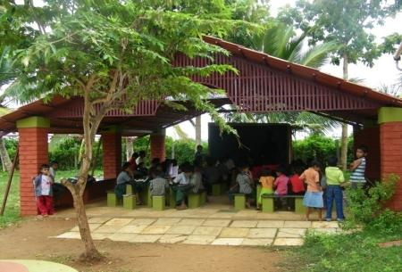
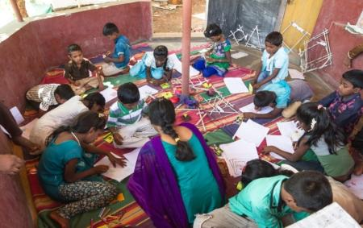
Facilities at Kaliyuva Mane
2.5 acres of green land
300+ trees
A play ground
An office
Conventional & Non-conventional learning areas
Multi purpose hall
Science laboratory
Library
Computer Laboraotory
Own Bored water well
15 KVA, 3 phase Diesel Generator set

Slide 17
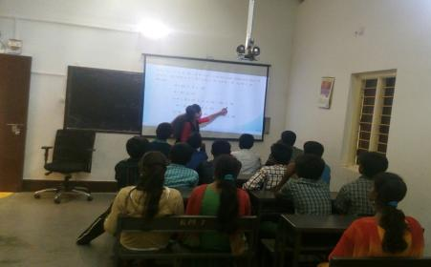
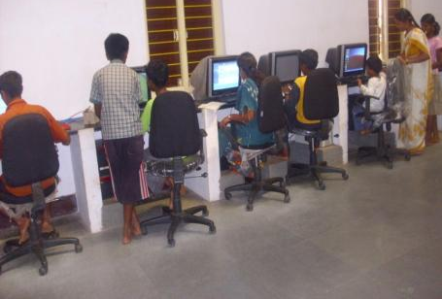
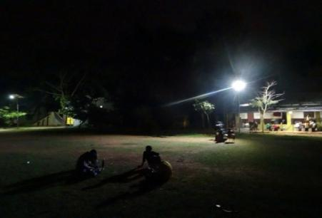
An eco-conscious solar school
Solar powered LED automatic campus lights.
Solar CFL/LED indoor lights
Solar powered Computer laboratory.
Solar digital smart classes (5 no.)
Solar support for Kitchen refrigerator & Grinder.
Solar water heaters

Slide 18
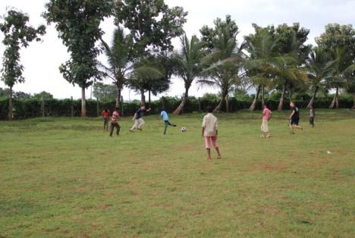
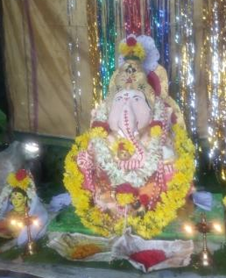
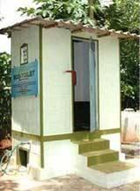
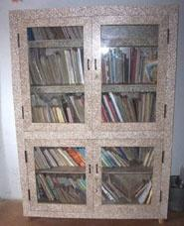
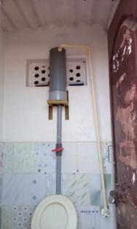
Other environmental activities
Organic farming
Eco friendly Ganesha made by kids
Hand made greeting card unit.
Dairy
Eco toilet
Eco chip boards in place of wood.
Astra stove and Gobar gas stove
Rain water harvesting
Bio mass boiler for hot water

Slide 19
Impact – 10th Standard Results
So far 45 children have passed out of 47 who appeared since 2010
3 dyslexic children have also passed out of 6 appeared
Some 10th passed out students are in colleges and some are already employed
Alumni have chosen courses like: B.E., C.A., B.Com., B.B.A., B.B.M., B.A., P.U.C., I.T.I, B.Sc., Nursing, Diploma in Engineering etc..,

Slide 20
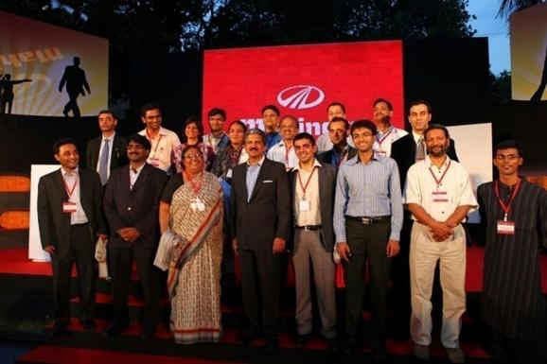
SPARK THE RISE, Don’t accept things as they are
Mahindra & Mahindra in its nation building program, invited innovative ideas
for the development of the nation, under the
“Spark The Rise” event
Our project “Education of the rural OUT OF SYSTEM children” emerged as 2nd runners up in the Grand finale held in April 2012 at Mumbai. Total 6000 ideas were submitted.

Slide 21
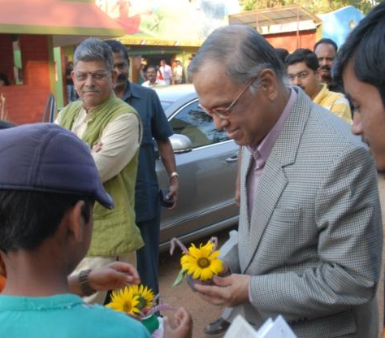
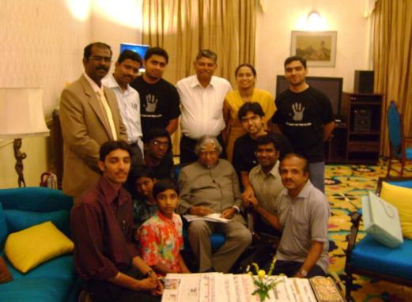
Good cause attracts great people
“Dream, Dream & Dream”
– Late Dr. APJ Abdul Kalam
Our memorable moments
with Dr. APJ Abdul Kalam,
when we met him at Lalit Mahal, in Mysore
“I’m so happy to see the wonderful work being done by Mr. Ananth and team to empower the
‘FORGOTTEN INDIA’.
- N R Narayana Murthy
(Visited us on 16th Jan. 2011)

Slide 22
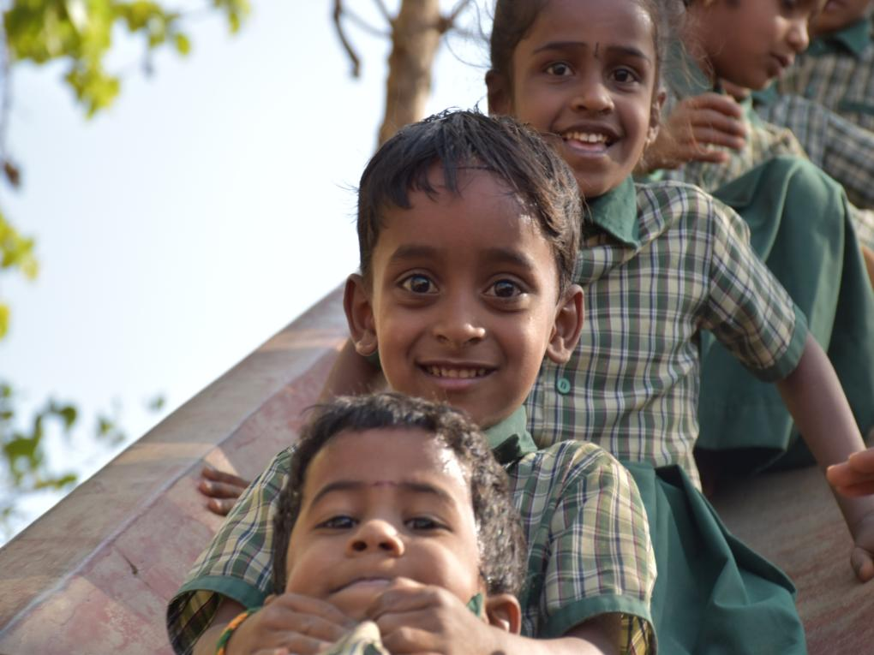
Happy mind learns faster

Slide 23
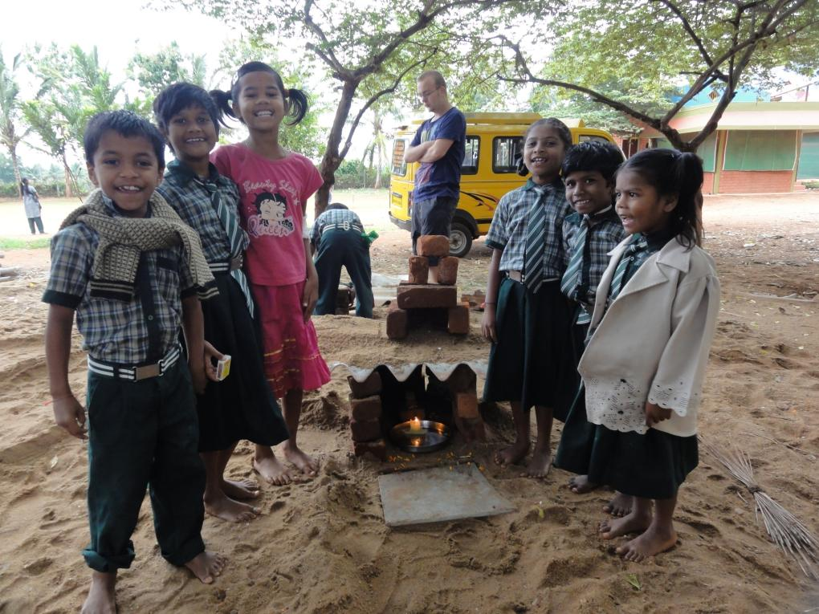
Happy mind exhibits positive energy

Slide 24
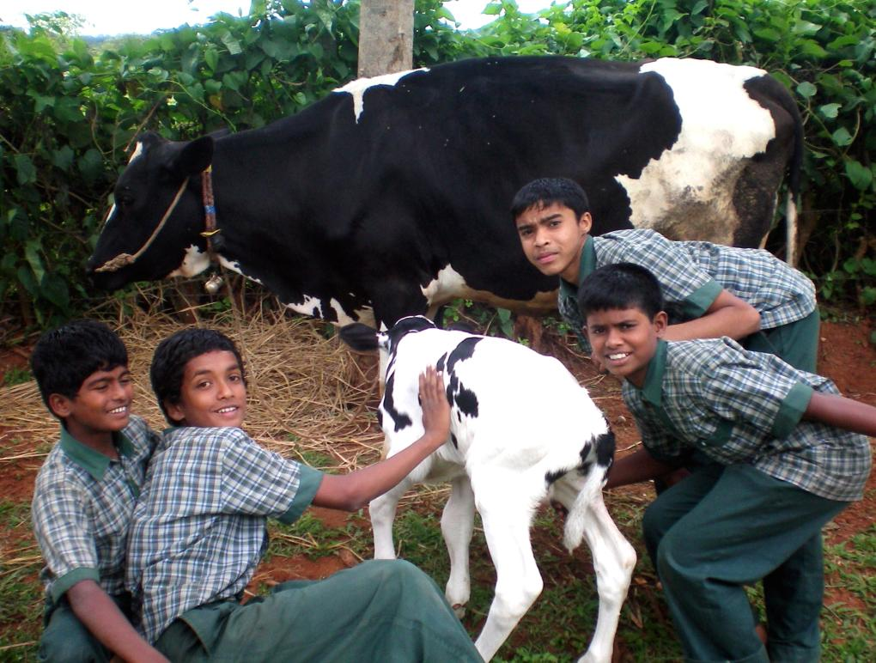
Happy mind brings compassion

Slide 25
Thank You for your time!!
Visit us to witness and experience happiness
Divya Deepa Charitable Trust
Kenchalagudu, Manandavadi Road,
Dhangalli Post, Mysuru-570008.
Phone: 8884310010, 9341369901
Email: divyadeepa.trust@gmail.com
Web:http://www.divyadeepatrust.org
Face Book:www.facebook.com/divyadeepa

